Slide 1
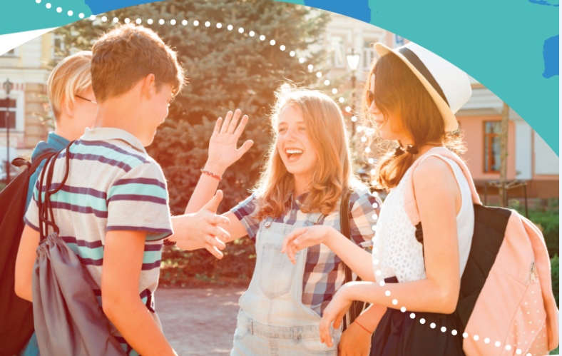
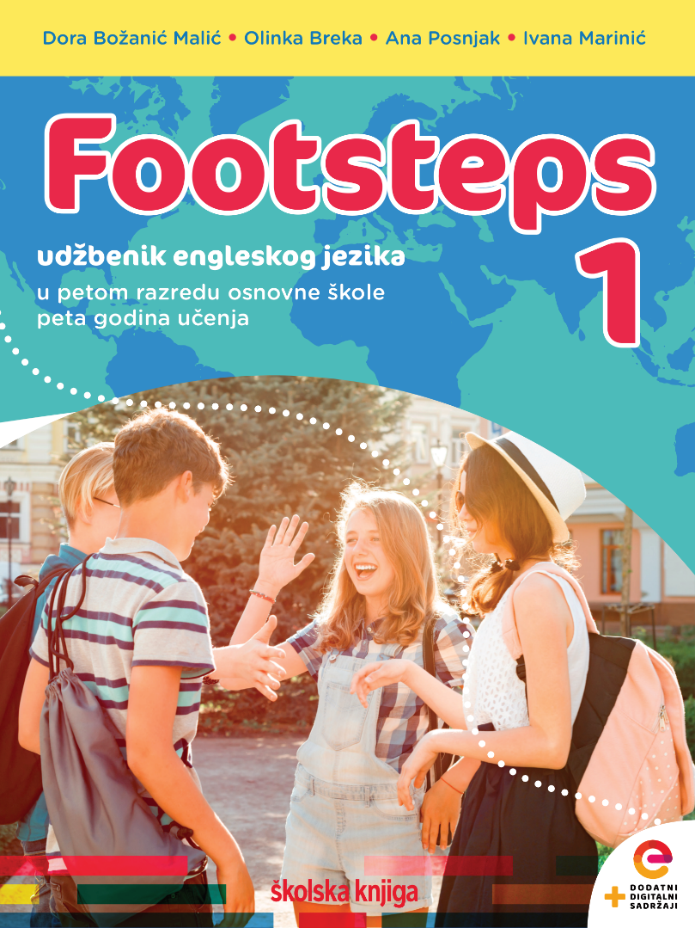

Culture spot
Easter traditions

Slide 2
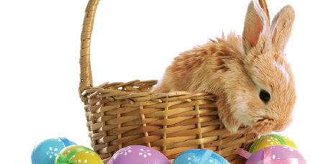
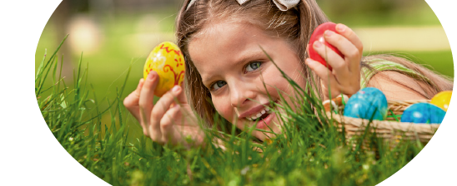
What do you know about Easter traditions?
How do people in Croatia celebrate Easter?
What do they do?
What do you do on Easter day?

Slide 3
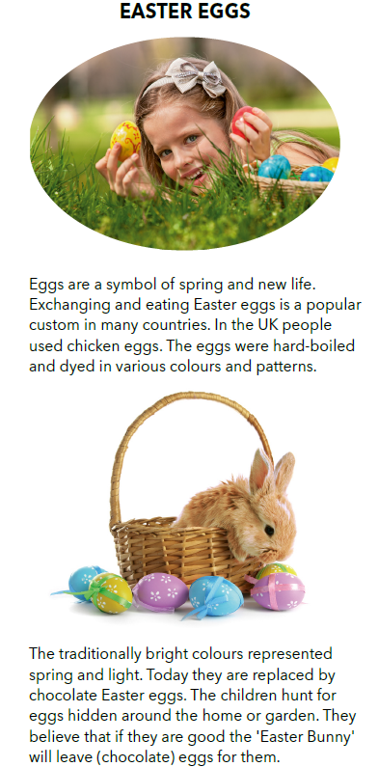
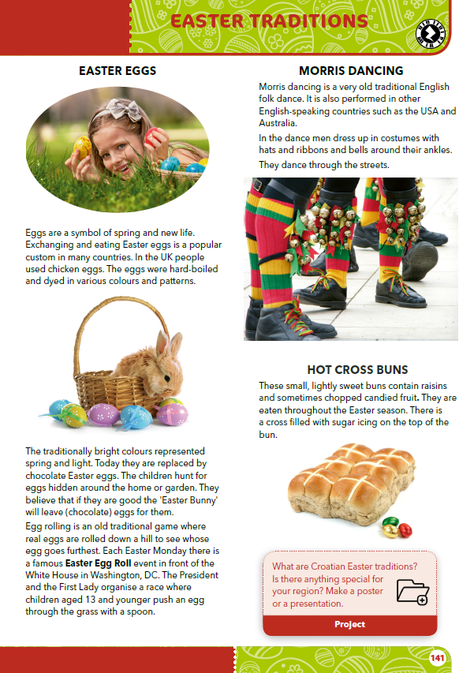
Read the text and answer the questions.
What do the eggs represent?
What do people do with the eggs?
Who leaves chocolate eggs behind?
Eggs represent spring and new life.
People dye hard-boiled eggs in various colours and patterns.Children hunt for eggs hidden around the home or garden.
The ‘Easter Bunny’ leaves chocolate eggs behind.
What can you see in the pictures?

Slide 4
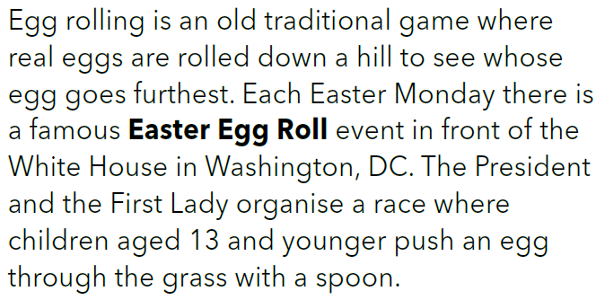
What is an Easter Egg Roll?
Where does the most famous Easter Egg Roll take place?
Easter Egg Roll is an event which happens each Easter Monday.
The most famous Easter Egg Roll takes place in front of the White House in Washington, DC.

Slide 5
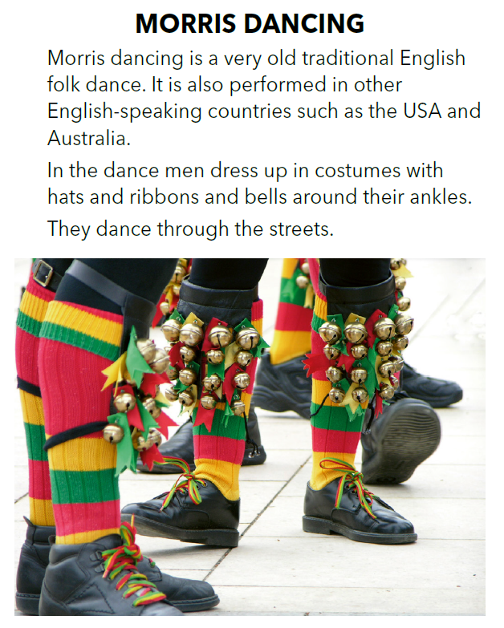
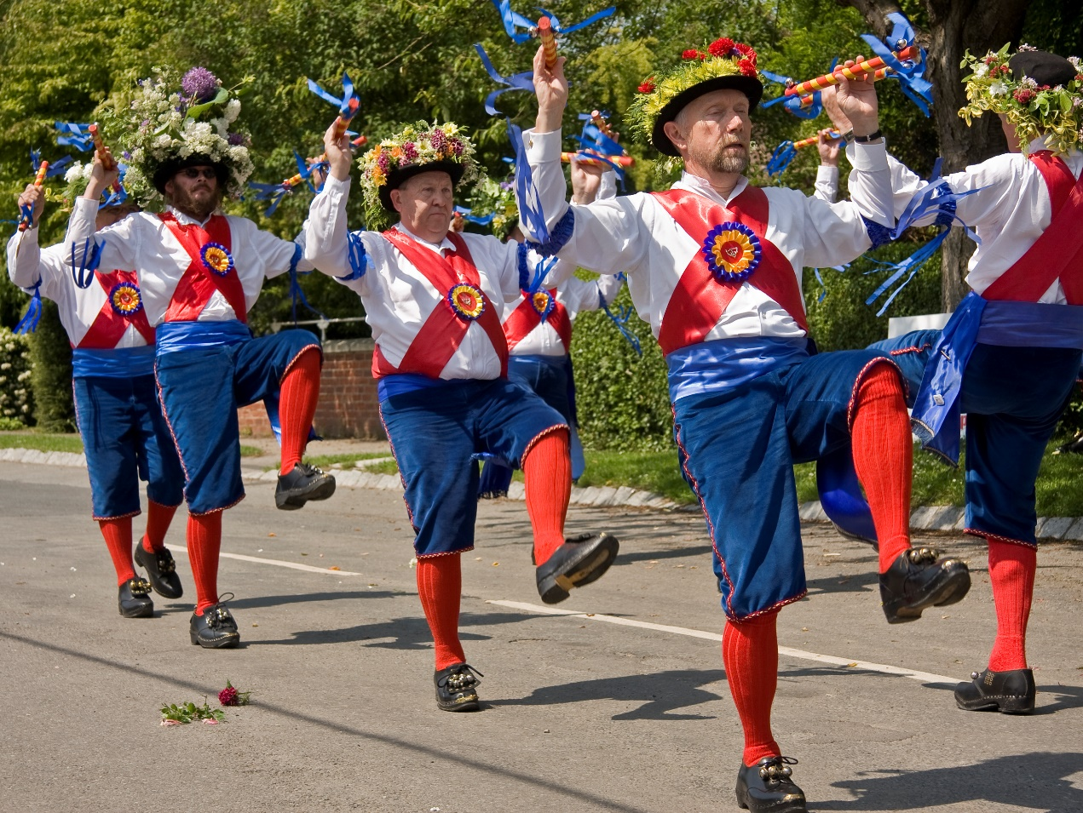
Who are Morris dancers?
Where do people go Morris dancing?

Slide 6
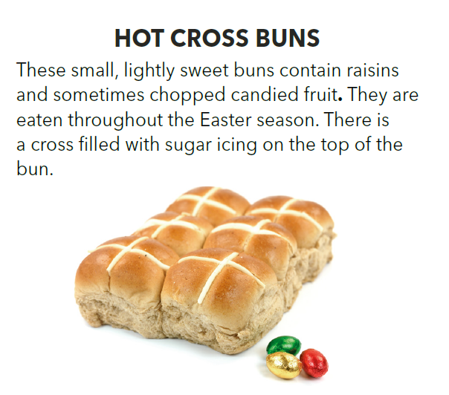
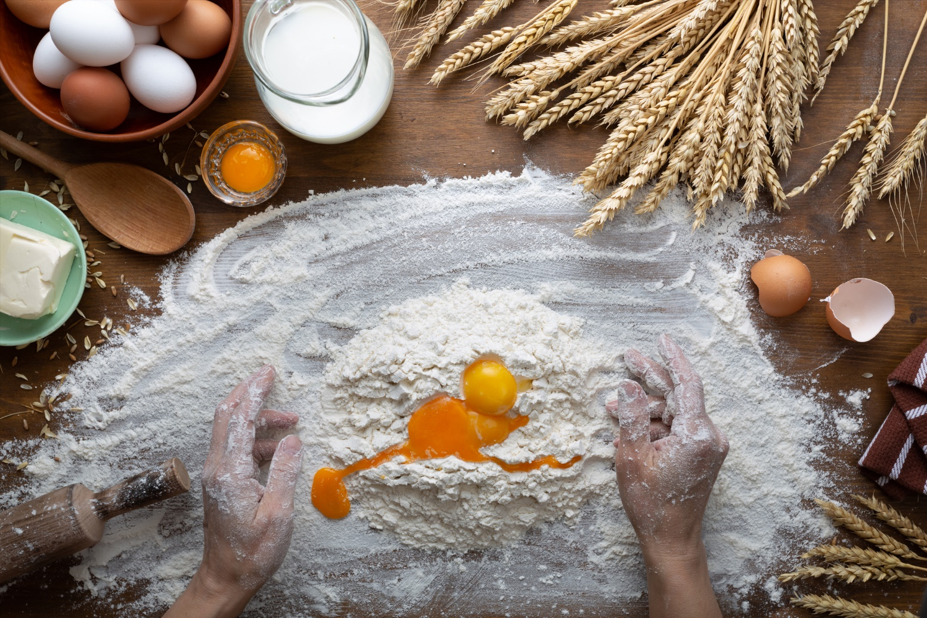
What do you need to make a hot cross bun?

Slide 7
